Slide 1

Supplement Sales Analysis
Bootcamp Data Analyst with SQL & Python using Google Platform
Dilla Octaviananda/PS16116

Slide 2


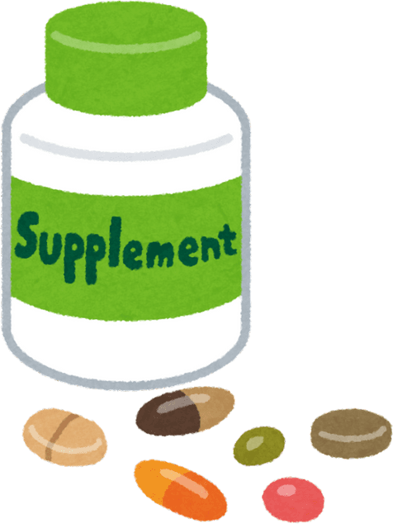

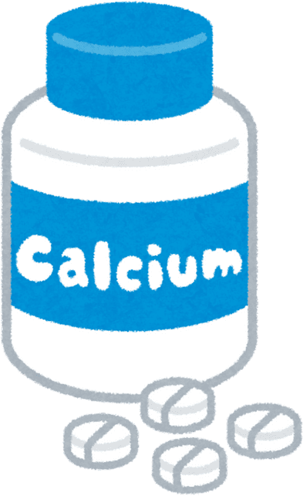
BACKGROUND
The increasing public awareness of a healthy lifestyle and the need for additional nutrition has driven a surge in demand for various types of supplements, such as vitamins, minerals, proteins, and herbs. Amidst the tight market competition, companies need to understand supplement sales trends in more depth in order to make the right and timely business decisions.
Therefore, a data analysis and visualization process is needed to transform complex sales data into easy-to-understand information. With this approach, companies can identify best-selling products, seasonal sales patterns, performance by region, and consumer behavior.

Slide 3
DATA DESCRIPTION
Dataset : Supplement_Sales_Weekly_Expanded.csv
From : Kaggle (comprises of 4312 records and 11 attributes)
This dataset contains weekly sales data for a variety of health and wellness supplements from January 2020 to April 2025. The data includes products in categories like Protein, Vitamins, Omega, and Amino Acids, among others, and covers multiple e-commerce platforms such as Amazon, Walmart, and iHerb. The dataset also tracks sales in several locations including the USA, UK, and Canada.
Date
Product Name
Category
Unit Sold
Price
Revenue
Discount
Unit Returned
Location
Platform

Slide 4





DATA PROCESSING
The data that has been taken from Kaggle, then data cleaning is carried out using several tools before further processing.
TOOLS
DATA CLEANING
GOOGLE COLAB
Date conversion
Remove duplicates
Check for missing values
Check for consistency of category and location columns
Check for unreasonable values ​​
(e.g. price 0, negative units, discount greater than 100%)
Validate that "Revenue" is calculated correctly as Units Sold * Price * (1 - Discount). Since it is different, recalculate it as Calculated_Revenue.
PHYTON
PANDAS
LOOKER STUDIO
Click below for the code :

Slide 5

EXPLORATORY DATA ANALISYS
The exploratory data analysis dashboard comprises of six sections:
Key Performance Index and Revenue Over Time
Revenue and Units Sold by Category
Revenue by Platform
Return Rates by Category
Top 10 Product by High Revenue
Unit Sold by Location

Slide 6


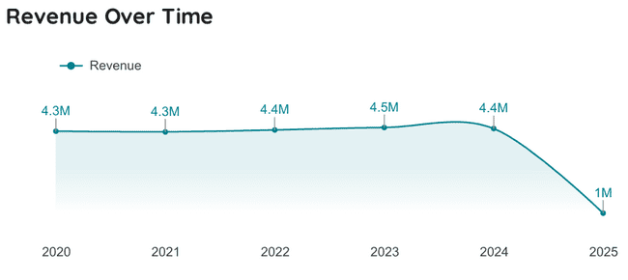
Key Performance Index and Revenue Over Time
Insights :
Supplement sales in 2020 to 2025 earned revenue of $22.91M with 658.5k products sold.
The average discount given per transaction is 12.4% for purchasing supplement products.
Units returned as much as 6.7k. This could be due to defective, damaged products or customers changing their minds.
Revenue from 2020 to 2024 is very stable and in 2025 revenue is only calculated from January to March so there is a decline in the graph.

Slide 7
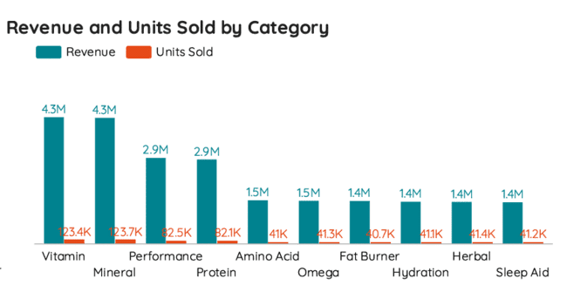
Revenue and Units Sold by Category
Insights :
The supplement category with the highest revenue is vitamins and minerals. While the lowest are fat burners, hydration, herbal and sleep aid.
The difference between the product categories with the lowest and highest revenues is quite large, while for products with medium revenues the difference is quite small.

Slide 8
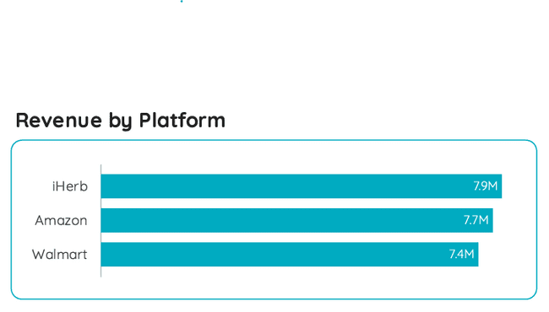
Revenue by Platform
Insights :
The highest revenue from supplement sales is on the iHerb platform at $7.9M. This could be because iherb is an e-commerce platform that specifically sells health and fitness products compared to the other two platforms.
From the graph, it can be seen that the income from the three platforms is not that different.

Slide 9
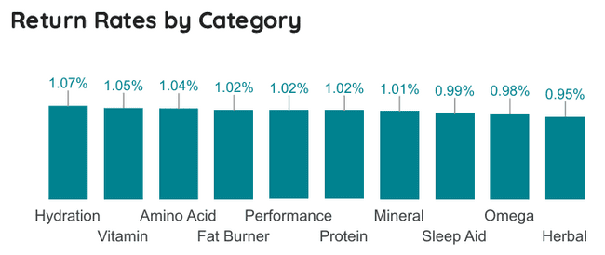
Return Rates by Category
Insights :
The product return rate for each product category is between 0.95% - 1.07%. This indicates that customers rarely feel disappointed or dissatisfied with the products they buy. This could indicate that the product quality is good enough, or the communication and information provided to customers is very clear.

Slide 10
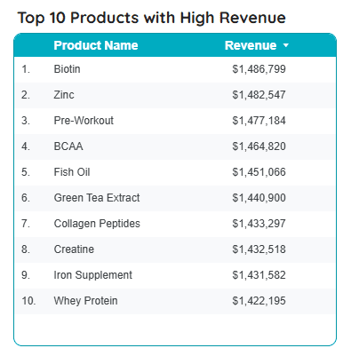
Top 10 Products with High Revenue
Insights :
The 10 highest-grossing products have nearly identical values, averaging over $1.4M, with Biotin products having the highest revenue.

Slide 11
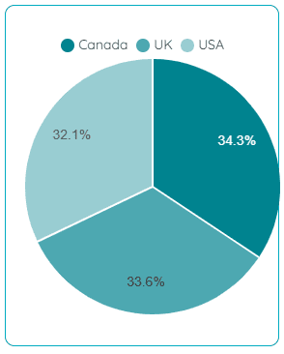
Units Sold by Location
Insights :
Distribution locations for supplement products include Canada, USA and UK. The largest number of units sold was in Canada at 34.3% and the smallest was in the USA at 32.1%.

Slide 12
RECOMMENDATION
Product categories with the lowest revenue such as fat burners, hydration, herbal and sleep aid need to be promoted more such as providing discounts, buy one get one products or bundling products in the same category.
Promote low-revenue products at the right times. For example, the beginning of the year (for health resolutions such as herbal products) or summer (for products such as Fat Burner and Hydration).
The iHerb platform has the highest revenue, therefore the company can provide a larger marketing investment to the iHerb platform. For the second position, which is Amazon, the company can focus on marketing with creative ads and displaying positive reviews from customers. The Walmart platform has the lowest revenue, on this platform you can apply a bundling strategy or buy one get one. For offline sales at Walmart, products can be placed on the front display so that they are easily seen by customers.
return rates in all product categories have a fairly small value with an average of only around 1%. Companies must be consistent in maintaining the methods currently used so that the quality and service provided to customers are satisfactory and the return rates remain low.

Slide 13
RECOMMENDATION
The top 10 products with the highest average revenue are sports and beauty related products. Therefore, companies can prioritize the sale of these products by providing more marketing through social media by endorsing influencers related to health and beauty.
To increase sales in the location with the smallest units sold, namely the United States, companies can focus on personalizing content, increasing distribution, and collaborating with local influencers to accelerate sales growth in that location.

Slide 14

THANK YOU
FOR YOUR ATTENTION

Slide 15
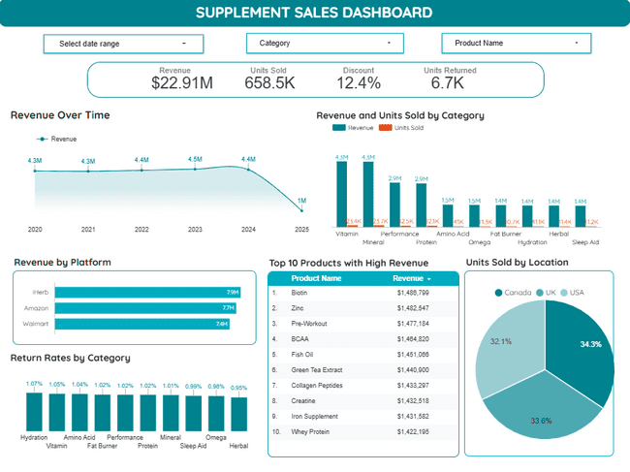

Exploratory Dashborad Preview
Click below for the dashboard :

